Slide 1
UNIT 3-SIMULATED ANNEALING EXAMPLE,APPLICATION,ADVANTAGES,DISADVANTAGES
Prof. Shilpa Gaikwad
TE AIDS

Slide 2
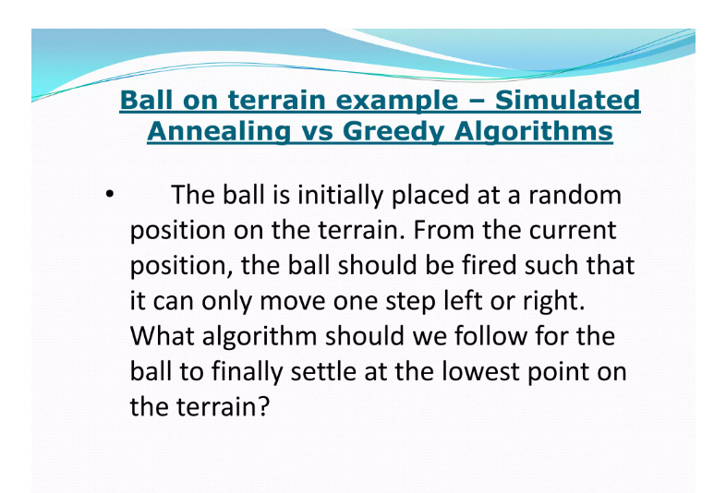
Example of Simulated Annealing

Slide 3
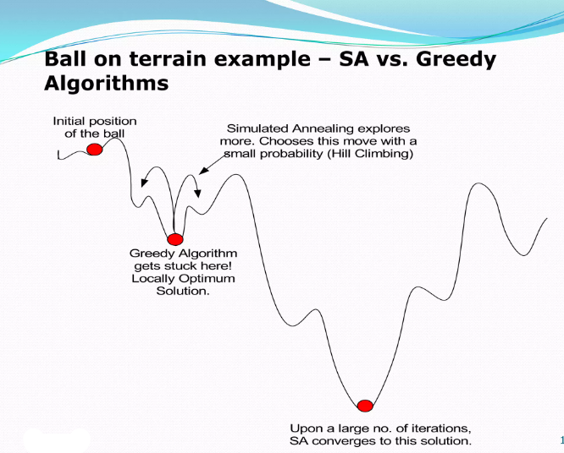
EXAMPLE OF SIMULATED ANNEALING

Slide 4
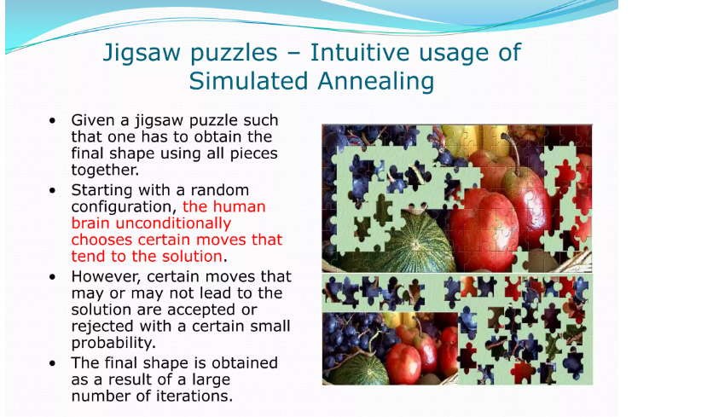
Example of Simulated Annealing

Slide 5
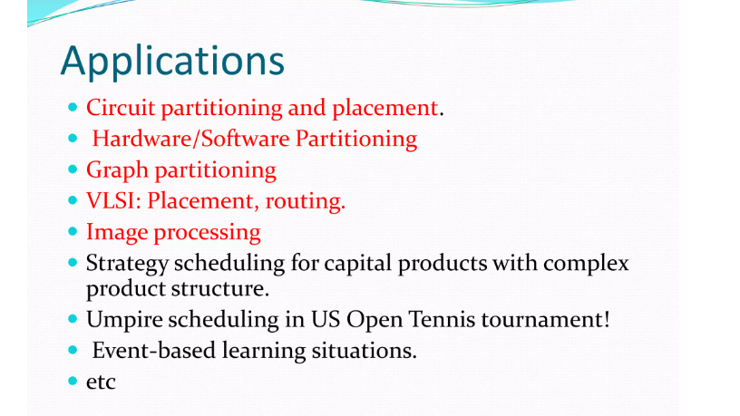
APPLICATIONS OF SIMULATED ANEALING

Slide 6
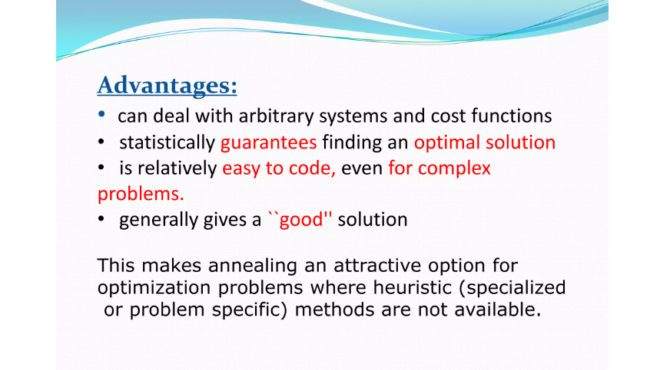
ADVANTAGES OF SIMULATED ANNEALING

Slide 7
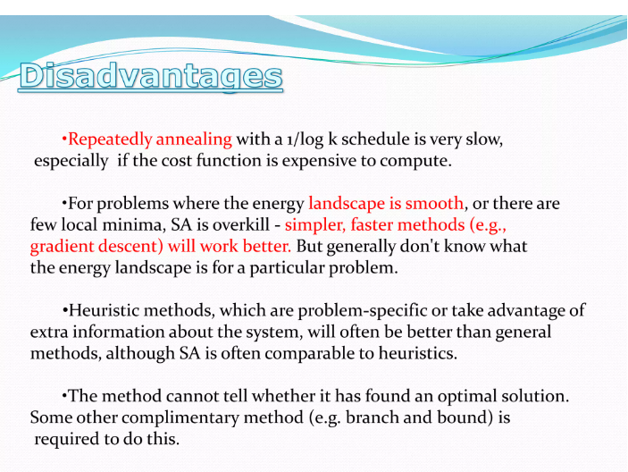
DISADVANTAGES OF SIMULATED ANNEALING

Slide 8
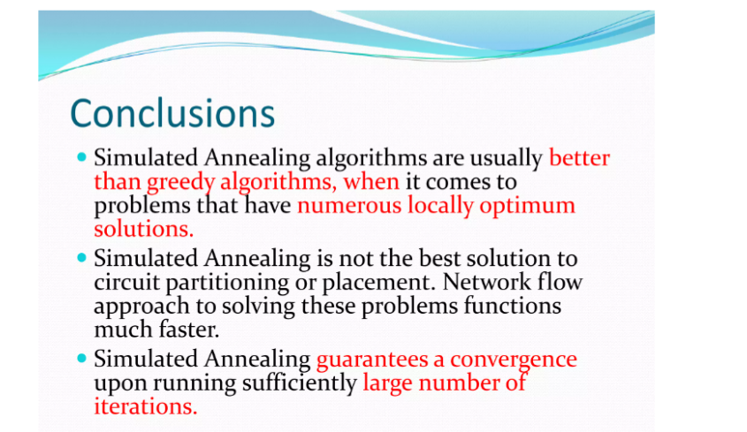
CONCLUSION

